Slide 1



Types of SSIS Automation
Notes:
If you have ever worked with SSIS packages you have at least thought about automation. And you might have done if by creating a database driven foreach tasks, highly parameterized packages or copying & pasting then modifying a package.

Slide 2
Benefits of Automated ETL Development
Efficiency
Automating the mass production of design patterns allows reliable solutions to drive operational processes.
Data Quality
Reliable ETL solutions lowers data quality risk.
Increased Productivity
An automated development solution generates opportunity for developers to work on additional projects and efforts.
Notes:
The idea of Automating SSIS package development is not new one and the benefits when realized are clear. It saves time and money.
Today, automation is so engrained in our development process that we often forget we are doing it, as a result the value is often overlooked.
Parameters and variables are used to achieve some level of automation in SSIS packages. Our CTS Standards encourage this by using variables and naming conventions and often our clients already have a design pattern in place for their ETL packages.

Slide 3
Copy and Paste Automation
One of our clients follows a standardized ETL convention, in addition they provided ample documentation on the queries to be used for the source and destination locations.
Our process for creating the ETL Packages was a follows:
1. Copy an existing ETL package
2. Modifying the Source
3. Modify the Destination
4. Modify the Names
5. Add Audit/Meta columns
6. Ensure Everything is Mapped Properly ←This was the majority of the work, the columns were not 1 to 1 and we were responsible for doing research
7. Test the Package
Notes:
When following a Standard Design Pattern as mentioned, Copy and Paste is often useful for reducing the amount of time it takes to create packages. While this practice is streamlined as much as possible, it time consuming and in my opinion, error prone due to repetitiveness. The only step that really requires human interaction is step 6. Using BIML, a novice developer following a tutorial could automate steps 1-5 within a few hours. Step 6 can be automated when column mappings are 1 to 1 or when you know the mappings in advance. In our situation this gives us much needed time for researching mapping issues and time to meet a demanding deadline.

Slide 4
What is Biml?
Biml is offered as a free Microsoft Visual Studio Add-In.
Biml can generate a variety of Microsoft SQL Server ETL objects:
SSIS Packages
SSAS Cubes
Tables
Notes:
BIML is a code generating utility capable of creating SSIS packages, SSAS cubes, and SQL Server tables.

Slide 5
What is Biml?
Biml is a dynamic code generating utility.
Biml: Business Intelligence Markup Language
Developed by Varigence.
Notes:
Before we begin, lets talk about BIML.
BIML is not open source. This is a product produced by Varigence.

Slide 6
What does Biml do?
Model SSIS Design Pattern in Biml
SSIS Package Template
Biml Code
Biml can Emulate SSIS Tasks and Transformations
Notes:
Create a template that hosts the design pattern
Model the package in Biml

Slide 7
What does Biml do?
SSIS Package: Table 1
Apply User Inputs
Code-Gen for Table 1
SSIS Package: Table 2
Execute Biml Script
Code-Gen for Table 2
SSIS Package: Table 3
Code-Gen for Table 3
Biml Code-Generates Packages Geared for Specific Table-Related Tasks
Notes:
Apply necessary input parameters into Biml; fro example, a table’s name.
Create the package(s) by executing Biml.

Slide 8
Benefit
Assume it takes 8 hours to develop Biml code that models a design pattern.
Working with the 20 minutes required to prep a template, Biml development time will break even when the 24th ETL solution is created.
For every hour of Biml development, the break even point is 3 ETL solutions.
Notes:
How does Biml pay for itself?

Slide 9
BIML == Creating a Template
Sharing is a Requirement
Reusability & BIML go hand in hand
Generalize & be Generic
Notes:
When you create a BIML script you are essentially creating a common template that can be called over and over again to create packages. Think of it as a function in code that returns a value. The value being returned in BIML script is a package.

Slide 10

Identifying BIML Candidates
Ask Questions -
What Changes?
What Stays the Same?
Is there a Pattern?
What databases are being used?
Notes:
Anytime you can copy & paste you could be using BIML

Slide 11
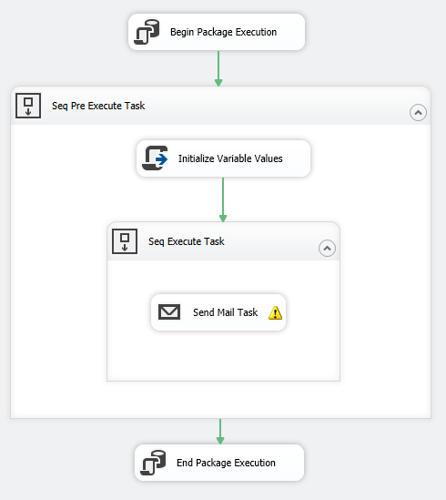
SSIS Package: 1
Design Pattern
Executes Non-ETL Related Tasks
Email
File Moves
TSQL Executions
Auditing: Consistent Documentation
One-To-One Relationship Between Package and Task
Notes:
Talk through how to automate

Slide 12
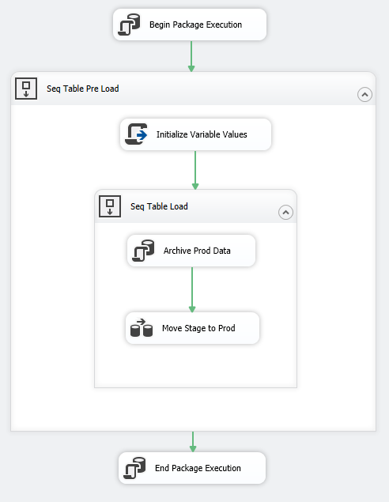
SSIS Package: 2
Design Pattern
Transports ‘Deleted’ Data to an Archive-Historical Table
Transports Staged Data to Production Table
Auditing: Consistent Documentation
One-To-One Relationship Between Package and Table
Impact on Key Business Elements
Notes:
Talk through how to automate

Slide 13
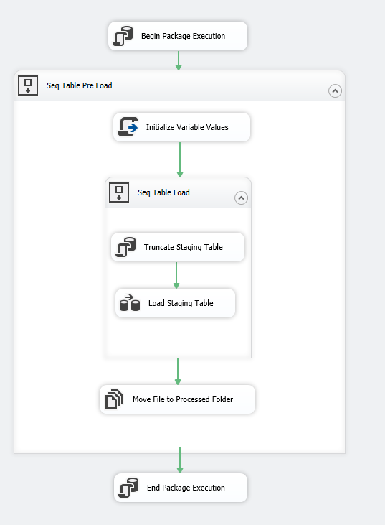
SSIS Package: 3
Design Pattern
Extracts Data from Feed
Transports Extracted Data into Staging Table
Moves a File to a ‘Processed’ Location
Auditing: Consistent Documentation
One-To-One Relationship Between Package and Feed
Data Source is Better Accounted For
One-To-One Relationship Between Package and Table
Impact on Key Business Elements
Notes:
Talk through how to automate

Slide 14
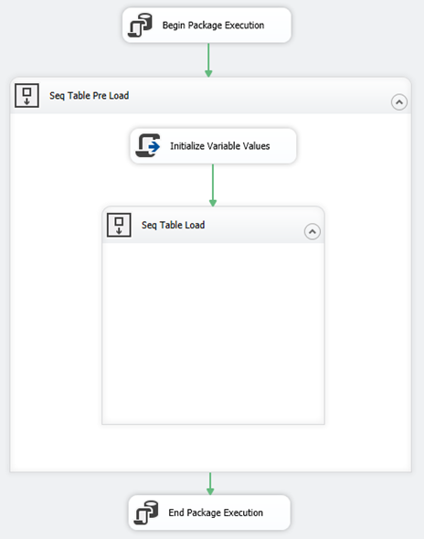
Is there a common pattern?
Notes:
Once identify a pattern you can share the same code between all your package. You will see this in the Biml Proof of Concept.

Slide 15
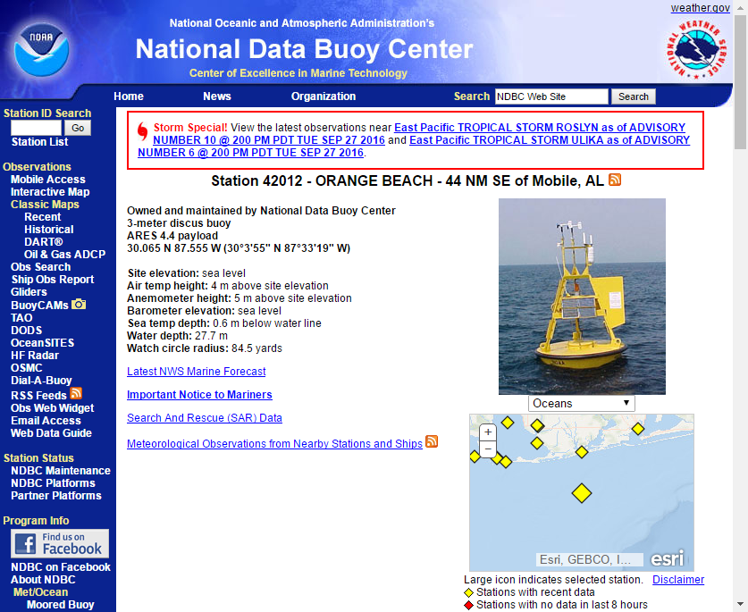
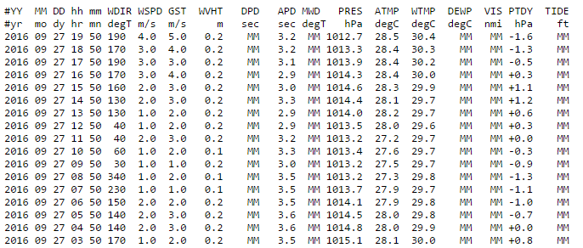
Biml Proof of Concept
Notes:
Lets walk through a real world example by creating a set of ETL packages that process Metrological data collected from sea buoys. The National Data Buoy Center provides the public free flat files for current and historical buoy data. The NDBC provides three different time frames, last 45 days, past months and past years.

Slide 16
Metrological Packages
RealTime – Reoccurring Job – 1 Package Processes 1 Buoy
This URL returns a Flat File for the Past 45 days
Monthly Historical – 1 Package Processes 1 Buoy’s Month
Year to Previous Month is Consolidated to ‘Monthly’ Flat Files
Each Month has its own URL
Yearly Historical – 1 Package Processes 1 Buoy’s Year
All Previous Years are consolidated to ‘Yearly’ Flat Files
Available Yearly files are dependent on the Buoy some have more than others
Each Year has its own URL
Notes:
To load all the Metrological data from a buoy we need to create a set of packages that process RealTime, past Months and past years data. Historical data is a one time load, after those packages are executed they can be deleted.

Slide 17
What Changes?
The HTTP Connection String
Source SQL Query for Cache
Number of Packages Generated
Year & Monthly have their own Master Package

Slide 18
Why use Multiple Packages for this Solution?
Usability
The packages are configured at the BIML level, nothing needs to be configured by the user.
Visibility
Its easy to look at the master package and tell if something failed.
No package is dependent on another if one fails it keeps going.
Url & Flat File Changes
Since it is not really an API, nor is it documented, there is nothing really holding them to keeping a consistent format for every Buoy
Biml Exposure – The original packages had an example of pretty much everything I needed to learn and it’s a real world example.
Notes:
In preparation for my SSIS project at work, I created the original SSIS package for importing the buoy data into my home Postgres SQL Server. The original package uses a foreach loop to grab the data for multiple buoys using the realtime URL only. This package could not be used for historical data. In order to accommodate the historical data loads I would have had to heavily parameterize the realtime package or create new ones. With Biml I have realtime and historical all in one shot.

Slide 19



Why Buoy Data?
Notes:
Imagine your at the beach and it’s the perfect day. The rip current is not bad, the surf is perfect, not too rough closer to the shore but big enough for the surfers in the distance.
Or how about kayaking and the water is perfectly still, there are dauphins swimming all around and the sky is beautiful.
For a long time I thought it was magic like a kid believing in Santa Cause. However after extensive research I realized that it has a lot to do with the swell height and wind direction. This information is publically available through the NBDC.

Slide 20
Lets Begin
Notes:
Now I will go into the technical side of Biml. My goal is to give you a basic understanding of the script and the amount of Code that is used. My example closing follows the design patterns I watched in the pluralsite exercise ‘Building Blocks of Biml’.

Slide 21
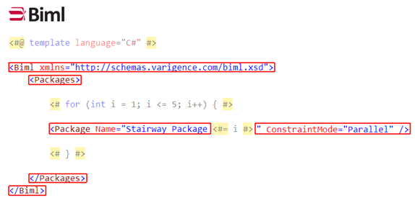
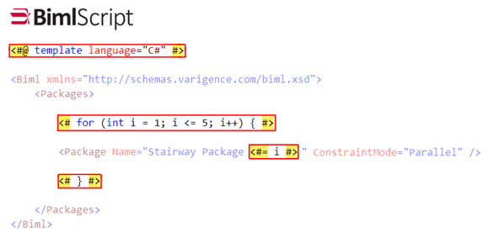
What does it look like?
Scripting Language
Similar to Razor or ASP.NET
Shares MVC Design Concept

Slide 22
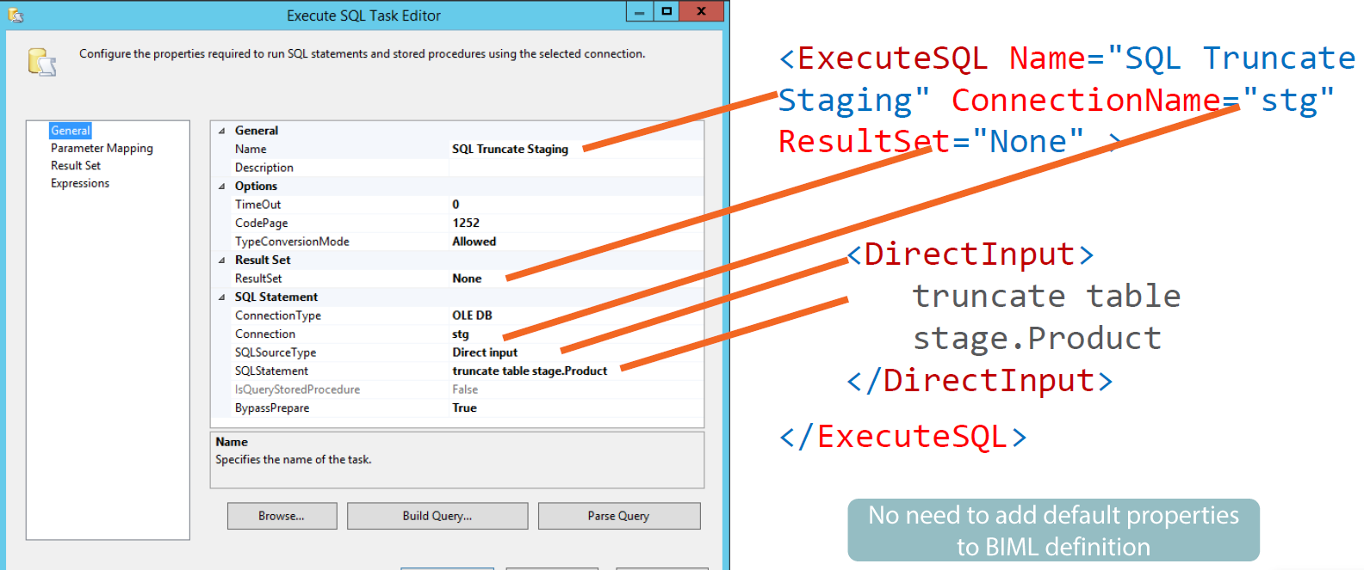
SQL Task

Slide 23
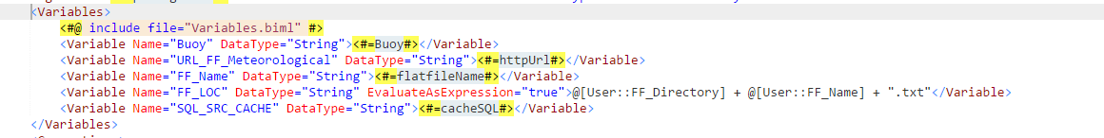
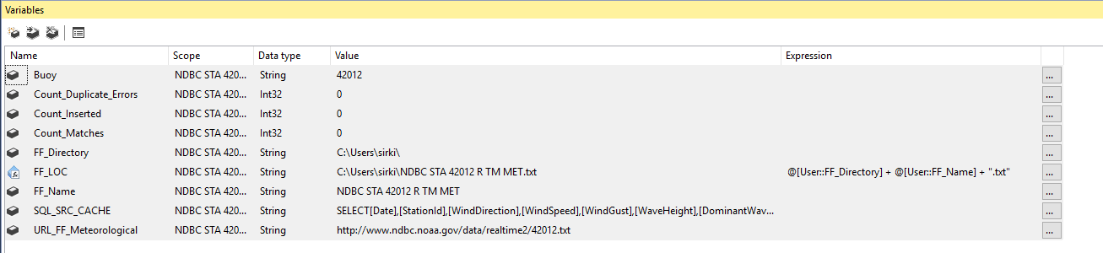
Variable Declaration

Slide 24
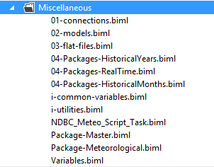
How is it Organized?
Tier Files
Include Files
CallBimlScripts()
C# Files
Notes:
BIML offers several different file types to use. I will walk through each type later in the presentation.

Slide 25
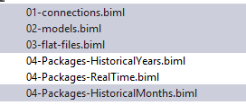
Tiers –Organize BIML Files
Notes:
Tiers can be thought of like partial views in MVC. In our case we have 3 different package templates that can be generated.

Slide 26
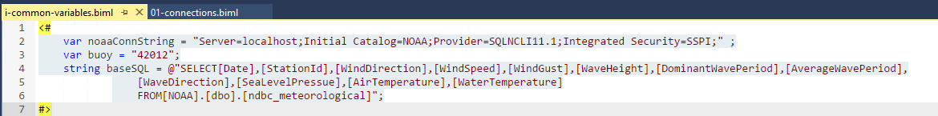
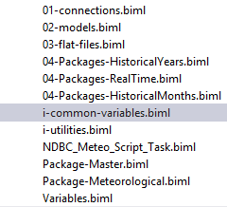
C# Files - Don’t Repeat Yourself
C# Variables are encouraged
Notes:
C# variables can be use to populate elements in Biml Script If it can be reused it should be in a variable

Slide 27
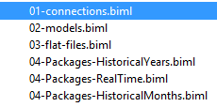
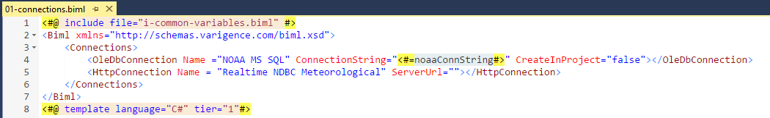
Connection Manager Tier
Notes:
This is where you define your connections. As you can see we are using the ConnectionString C# variable that is defined in our common file referenced in the previous slide. Notice only the HTTP Connection and SQL Instances are defined here. The cache and flat files are defined in the flat file tier which we will get into later.

Slide 28
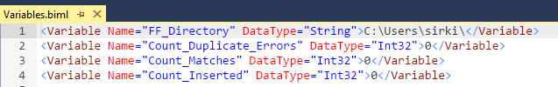
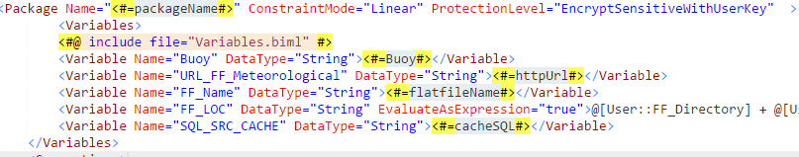
Include Files
Notes:
Include files are common files that do not change. These values are static and are shared but not changed across packages.

Slide 29
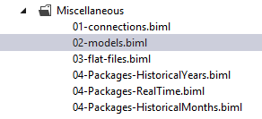
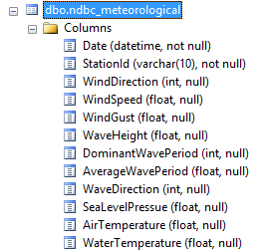
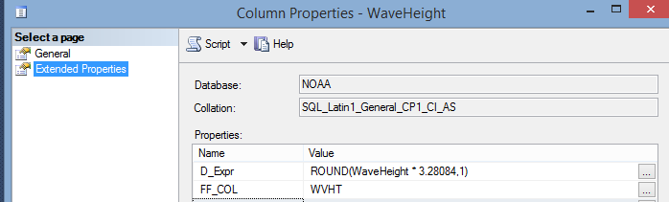
Models
Same as Database First Models in MVC
A Table Schema is Represented as a C# Object
Implements Data Annotation Properties
Notes:
One of the coolest features of the Biml C# framework is its ability to create Models from a database schema. This allows you to grab what you need once and use it later on and you end up using the table schema a lot.

Slide 30
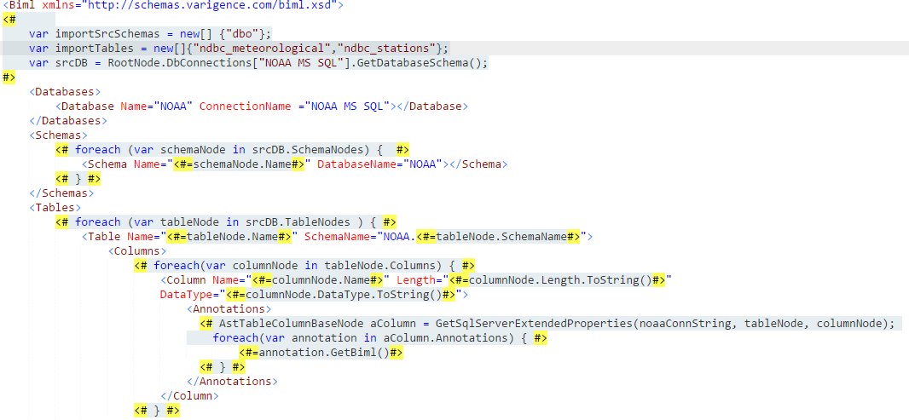
Models continued
Notes:
While I do not intend to walk through this code. I do want to point out that this is all done dynamically. In this situation it creates a table Model for each table in the our database.

Slide 31
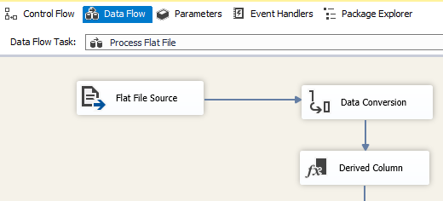
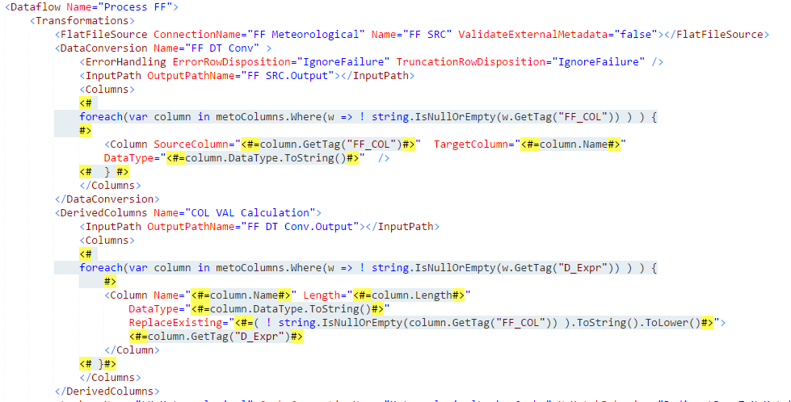
DataFlow Task: Models in Action

Slide 32
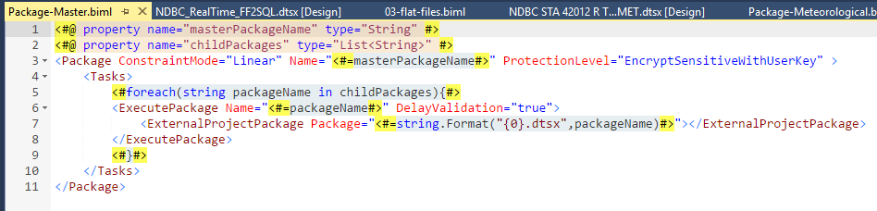
Using CallBimlScript()
Notes:
In this example we are create a Biml function that generates a simple master package that calls child packages.

Slide 33
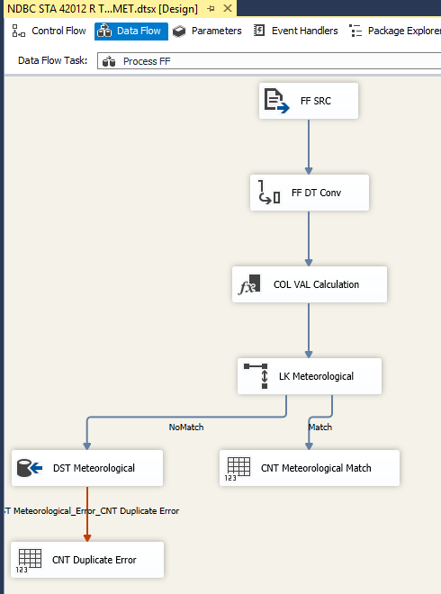
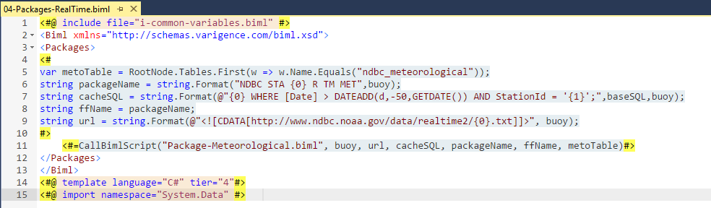
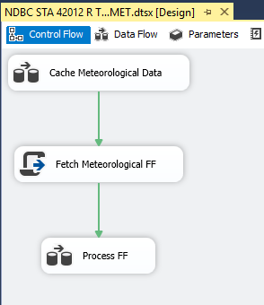
What does a Package Look Like?
Notes:
This is the RealTime Package. Since the core package contents do not change much between the packages. The package itself is actually in its own file that gets called by each of the packages.

Slide 34
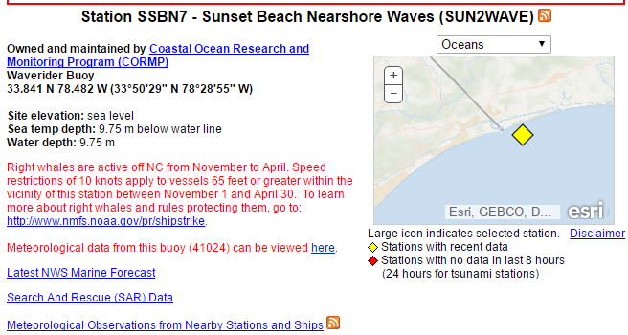

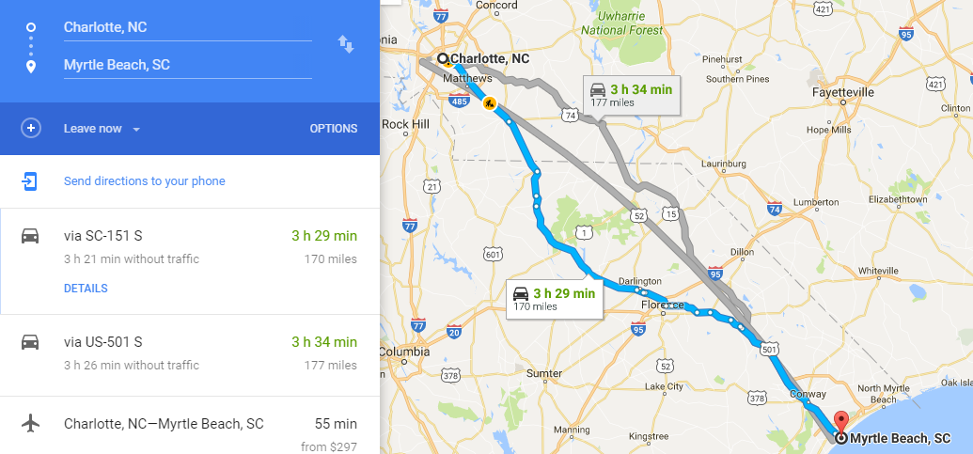
Demo
Notes:
Lets plan a weekend trip, say Myrtle Beach. You want to know if you should pack your surfboard. While we the only data we have is past and present we can get a ballpark estimate if there will still be a swell by the weekend.

Slide 35
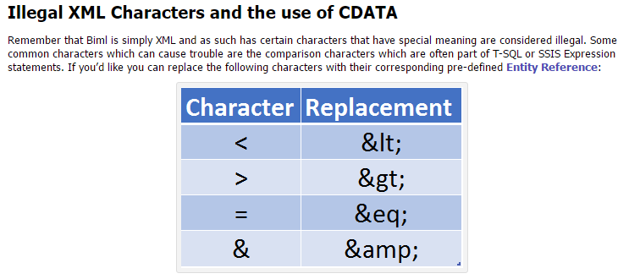
Pitfalls
Notes:
While this is an XML pitfall, escaping characters in XML is not the cleanest of ways do to things. Im my case I had a url that was littered with things that needed to be escaped and it was a C# variable. After trial and error I ended up wrapping it with CDATA

Slide 36
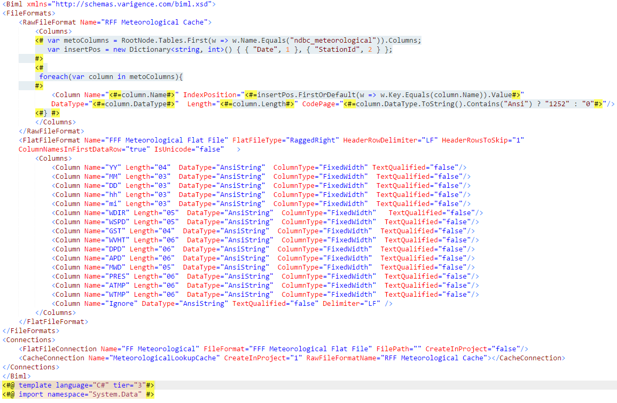
Pitfalls: Flat Files & SQL Cache ☹
Notes:
Working with Flat Files and SQL Cache in Visual studio is seamless, in BIML there is a learning curve. Using a SQL Cache requires you to define a flat file format for it. While the end result code is not complex, it takes a little be of trial and error to get it just right.

